Slide 1

Information Systems Capstone
-
Tata Consultancy Services
-
IST 755
Tata Consultancy Services
Presented by Tanmay Kamble

Slide 2
As the largest IT services company in India and among the top globally, TCS combines technological strength, domain expertise, and scale to compete with top players like Accenture, IBM, and Infosys.
01
Company Overview
TCS is known for its Global Delivery Model (GDM), which leverages talent across geographies to deliver efficient, high-quality solutions. Its offerings span cloud transformation, data analytics, cybersecurity, artificial intelligence, and enterprise software.
02
Tata Consultancy Services (TCS) is a global leader in IT services, consulting, and digital solutions, serving over 600 Fortune 500 clients across 46+ countries. Renowned for its Global Delivery Model, TCS combines technical expertise with cost efficiency to drive large-scale digital transformation. With deep investments in AI, cloud, and emerging technologies, TCS is shifting from a traditional service provider to a forward-thinking technology partner for the world’s leading organizations.
02
TCS invests significantly in emerging technologies, including AI, machine learning, quantum computing, and blockchain. Tools like Ignio (AI automation platform) showcase its push toward intelligent enterprise solutions.
03

Slide 3
Strategic Landscape
Capstone Project
TCS operates in a highly competitive global IT landscape. A SWOT analysis shows its strengths in brand reputation, innovation, and global reach. However, its over-reliance on third-party cloud providers and challenges in retaining top talent remain critical concerns. From a PESTELI perspective, the industry is being shaped by rapid growth in AI, cloud adoption, and digital transformation. At the same time, regulatory demands like GDPR and CCPA, along with economic pressures and data localization laws, introduce new complexities.
Through Porter’s Five Forces, it’s evident that TCS faces strong competitive pressure from global players such as Accenture, IBM, and Infosys. The bargaining power of clients is increasing as they demand end-to-end digital solutions with better value and flexibility. Additionally, emerging technologies like Web3, blockchain, and automation are disrupting traditional service models. To stay ahead, TCS must innovate, build proprietary platforms, and evolve beyond its traditional service-centric identity.
-
IST 755
03

Slide 4
04
01
03
TCS follows the Sense – Seize – Transform model to adapt, evolve, and lead in a rapidly changing digital landscape.
Establish a high-impact consulting division, repositioning TCS as a strategic advisor in digital transformation.
Dynamic Capability Framework
02
04
Focus on building a proprietary cloud platform and scaling AI automation tools like Ignio to reduce dependency on third-party providers.
Launch AI-powered cybersecurity platforms and blockchain-based solutions to meet next-gen enterprise security demands.
Capstone Project
-
Tata Consultancy Services
-
IST 755

Slide 5
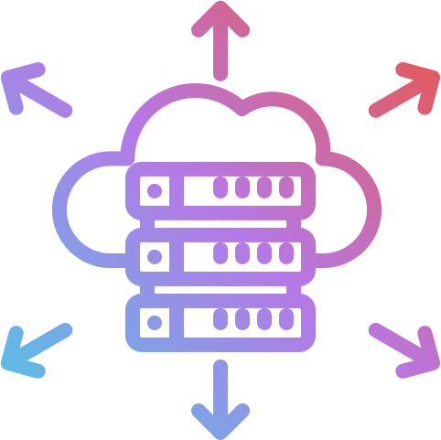
Cloud Transformation Roadmap
Strategic Alignment
Platform Development
01
Define cloud strategy and long-term vision
Appoint Chief Cloud Officer (CCO)
Align leadership and secure initial funding
04
Build hybrid/multi-cloud infrastructure with Ignio integration
Embed data privacy, security, and compliance from day one
Run internal pilots for scalability and performance
Building a Smarter, Secure Future for TCS
Capability Assessment
Client Migration & Market Entry
02
Audit existing infrastructure and cloud competencies
Identify gaps in talent, tools, and compliance readiness
Set benchmarks for cloud performance and AI integration
05
Begin transitioning selected clients to TCS Cloud
Develop pricing models: subscription-based / pay-per-use
Build marketing campaigns to position TCS as cloud-first
Team Mobilization
Optimization & Growth
05
03
Set up dedicated Cloud & AI division
Launch internal training programs on cloud, AI, and DevSecOps
Begin hiring cloud architects and cybersecurity specialists
Launch full-scale commercial rollout
Continuously upgrade platform features and security layers
Collect feedback and build next-gen cloud innovation roadmap
06

Slide 6

Transforming into a Strategic IT Advisor
Capstone Project
TCS has built a strong reputation in IT services but still trails global consulting leaders like McKinsey, Accenture, and Deloitte in the high-value advisory space. To shift this perception, TCS must establish a dedicated consulting division with focused leadership, its own goals, and a clear mandate to deliver strategic transformation solutions. This new arm should foster cross-functional collaboration with technical teams to offer holistic, end-to-end services.
To fuel this growth, TCS should upskill internal teams in consulting methodologies and business strategy while also recruiting experienced professionals from leading firms. At the same time, a strong marketing push is needed to rebrand TCS as a strategic advisor through client success stories, thought leadership, and targeted outreach. This repositioning will enhance TCS’s credibility, drive higher-value engagements, and build deeper, long-term partnerships with enterprise clients.
-
IST 755
06

Slide 7
07
Weaknesses
Threats
SWOT Analysis
Limited in-house innovation culture historically focused on service delivery.
Product development and commercialization are relatively new areas for TCS and require significant cultural and financial shifts.
Fierce competition from cybersecurity giants like Palo Alto Networks, IBM Security, and Symantec.
Constantly evolving cyber threats and compliance requirements pose long-term innovation and scaling challenges.
Strengths
Opportunities
TCS has strong technical foundations in AI and automation with platforms like Ignio.
It has established trust with clients in sensitive industries like finance, healthcare, and public sector—ideal for launching cybersecurity and blockchain solutions.
Rising demand for real-time threat detection, zero-trust security, and blockchain-based identity management.
Strategic partnerships with governments and Fortune 500 firms can accelerate co-development and market entry.

Slide 8
Strategic Planning Management
Phase 1: Foundation
Strategy alignment, R&D kickoff, hiring (0–6 months)
Phase 2: Development
Cloud build, consulting setup, and MVPs (6–18 months)
TCS
-
Capstone Project
Phase 3: Go to Market
Platform rollout, pilot projects, branding (18–30 months)
09
Phase 4: Scale
Expansion, feedback loop, optimization (30–36+ months)

Slide 9
What I Learned from This Capstone
Capstone Project
This capstone journey taught me that innovation goes far beyond technology, it’s rooted in the right people, a supportive culture, and a clear, courageous vision. Tools and platforms are important, but they only become powerful when backed by an organization that’s willing to think differently and act boldly.
Strategic transformation isn’t about one big idea, it’s about executing consistently over time. TCS has all the raw ingredients to lead the next era of digital evolution, but true leadership will come only when it owns what it builds. Ultimately, I’ve learned that timing, clarity, and courage are what drive lasting impact in an industry defined by change.
-
IST 755
10

Slide 10
IST 755
-
Tata Consultancy Services
-
Capstone Project
Thank You

